Slide 1


01AI0403-Object Oriented Design and Programming
Object Oriented Design and Programming (01AI0403)
Unit – 8
Stream and Files

Slide 2



Outline
Concepts of Streams
Stream Classes
Unformatted Data
Unformatted I/O Operations
Getline() & write() fuctions
Formatted Data
Formatted Console I/O operations.
ios Format Function
Stream Manipulators
File
File Handling
File Pointer
Error Handling during file operations.

Slide 3
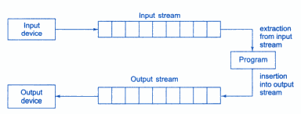
Concepts of Streams
Stream
Transformation of information in the form of a sequence of bytes.
I/O Operations:
Input:
A stream that flows from an input device ( i.e.: keyboard, disk drive, network connection) to main memory
Output:
A stream that flows from main memory to an output device ( i.e.: screen, printer, disk drive, network connection)
Data streams

Slide 4
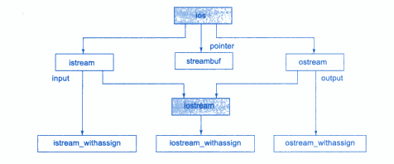
Stream Classes
ios
istream and ostream inherit from ios.
iostream inherits from istream and ostream.
<< (left-shift operator)
Overloaded as stream insertion operator
>> (right-shift operator)
Overloaded as stream extraction operator

Slide 5
Unformatted Data
The data with default setting by the I/O function of the c++ is known as unformatted data.
It is the basic form of input/output and transfers the internal binary representation of the data directly between memory and the file.
For example, in cin statement it asks for a number while executing. If the user enters a decimal number, the entered number is displayed using cout statement. There is no need to apply any external setting, by default the I/O function represents the number in decimal format.

Slide 6
Unformatted I/O Operations: Overloaded Operator >> and <<
>> operator is overloaded in the istream class
Ex: cin>>x>>y>>z;
It reads the data character by character and assigns it to the indicated location. The reading for a variable will be terminated at the encounter of a white space or a character that does not match the destination type.
int code;
cin>>code;
Suppose the following data is given as input:
425D
>> Operator will read characters upto 5 and assign 425 to code. Character ‘D’ remains in the input stream and will be the input to the next cin statement.

Slide 7
getline() and write() functions
getline() reads a whole line of text that ends with a newline character. Reads an entire line from an input stream (like cin or a file).
Syntex: cin.getline(line, size);
It will read the character input into variable line until either ‘\n’ encountered or size-1 characters are read (whichever occur first).
The newline character is read but not saved. Instead it is replace by null character.
The write() function displays an entire line. Writes a specified number of characters to an output stream (like cout or a file).
Syntex: cout.write(line, size);
Line represents the name of the string to be displayed and size indicates the number of characters to display.
Note that If the size is greater than the length of line, then it displays beyond the bounds of line.

Slide 8
Formatted Data
C++ supports a number of features that could be used for formatting the output. These features include:
ios class functions and flags.
Manipulators.
User defined output functions.

Slide 9
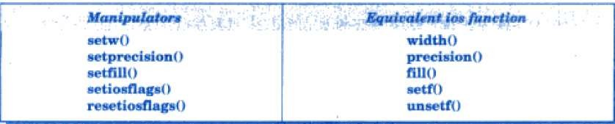
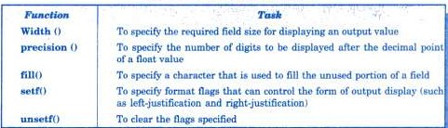
I. Formatted Console I/O operations

Slide 10
ios Format Functions
1. Width()
Syntax: cout.width(w);
We can use the width() function to define the width of a field necessary for the output of an item.
We have to use object to invoke it.
cout.width(5);
cout<<543<<12<<endl;
cout.width(5); cout<<543; cout.width(5); cout<<12;

Slide 11


ios Format Functions
2. Precision()
Syntax: cout.precision(d);
By default, the floating numbers are printed with six digits after the decimal point.
However, we can specify the number of the digits to be displayed after the decimal point while printing the floating-point numbers.
This can be done by using the precision() member function.
cout.precision(3); cout<<1.14159<<endl;
cout<<sqrt(12)<<endl; cout<<2.50032<<endl;
cout.width(5);
cout<<543<<12<<endl;
3. Fill()
Syntax: cout.fill(d);
cout.fill(‘*’); cout.width(10); cout<<5250<<endl;

Slide 12
ios Format Functions
4. Setf()
The setf() function is used to set specific formatting flags for output operations using cout. It allows fine control over how numbers, alignment, and other output elements are displayed.
Syntax: cout.setf(flag_arg1,bit_field_arg2);
arg1: A formatting flag from the ios class that specifies the required formatting.
arg2: A bit-field constant from ios that defines the category of arg1.
Example:
cout.setf(ios::left, ios::adjustfield);
cout.setf(ios::scientific, ios::floatfield);
cout.width(5);
cout<<543<<12<<endl;

Slide 13
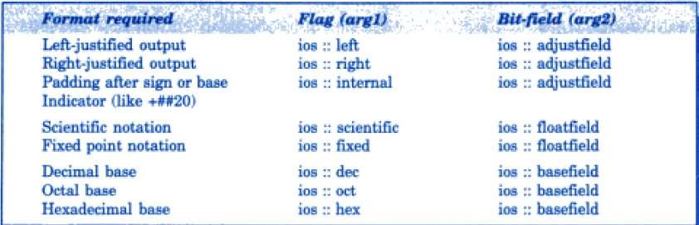
ios Format Functions
4. Setf():
#include <iostream>
using namespace std;
int main() {
cout.setf(ios::hex, ios::basefield);
cout << 255 << endl;
return 0;
}
OUTPUT:
ff

Slide 14
II. STREAM MANIPULATORS
The header file iomanip.h provides a set of functions called manipulators, which can be used to manipulate, the output formats.
They provide the same features as that of the ios member functions and flags. Some manipulators are more convenient to use than their counterparts in the class ios.
Function | Manipulator | Meaning
Width() | Setw() | Set the fields width
Precision() | Setprecision() | Set the floating point precision.
Fill() | Setfill() | Set the fill character.
Setf() | Setiosflags() | Set the format flag.
Unsetf() | Resetiosflags() | Clear the flag specified.
“\n” | endl | Insert a new line and flush stream.
cout.width(5);
cout<<543<<12<<endl;

Slide 15
Difference b/w manipulators and ios member function
The ios member function return the previous format state which can be used later, if necessary. But the manipulator does not return the previous format state.
In case, we need to save the old format states, we must use the ios member functions rather than the manipulators.
However, the key difference is:
ios member functions return the previous format state, allowing it to be saved and restored later.
Manipulators (setprecision, etc.) do not return the previous state, so you cannot restore them easily.
Example:
cout.precision(2); // previous state
int p = cout.precision(4); // current state
When these statements are executed, p will hold the value of 2(previous state) and the new format state will be 4.
We can restore the previous format state as follows:
cout.precision(p); // p = 2
cout.width(5);
cout<<543<<12<<endl;

Slide 16
Designing our own manipulators
Syntax :
ostream& manipulator_name(ostream& output){
………….. code
…………..
return output;
}
Example:
Defines a manipulator called unit that display “inches”.
ostream& unit(ostream& output){
output<<“ inches”;
return output;
}
cout<< 10 << unit; // it will produce following output
10 inches
cout.width(5);
cout<<543<<12<<endl;

Slide 17
Designing our own manipulators
By default, precision(n) controls the total number of significant digits, not just the decimal places.
Example:
#include <iostream>
using namespace std;
ostream& show(ostream& output) {
output.width(10);
output.fill('*');
output.precision(4); // Set precision to 4 decimal places
return output;
}
int main() {
cout << show << 12.34567 << endl;
return 0;
}
Output:
*****12.35
cout.width(5);
cout<<543<<12<<endl;

Slide 18
File
A file is a collection of related data stored in a particular area on the disk. The data is stored in disk using the concept of file
Why File?
Permanent storage of data: (all the message or value printed with help of any output statements like printf, cout, putchar are never available for future use).
If there is a large amount of data generated as output by a program, storing that output in file will help in easy handling /analysis of the output as user can see the whole output at any time even after complete execution of the program.
cout.width(5);
cout<<543<<12<<endl;

Slide 19
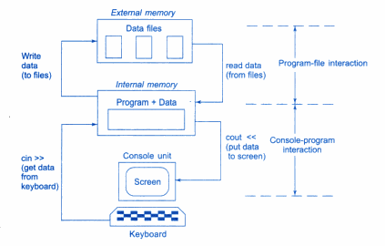
File
cout.width(5);
cout<<543<<12<<endl;

Slide 20
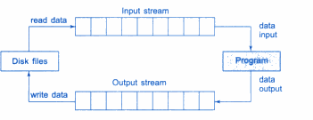
File Input and Output Streams
C++ handles file operations which are very similar to the console input/output operations.
File Input Stream: reads data from disk file to the program.
File output Stream: writes data to the disk file from the program.

Slide 21
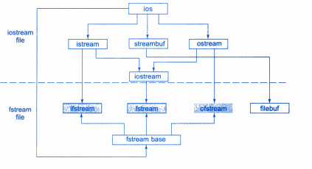
File stream classes for file operations
cout.width(5);
cout<<543<<12<<endl;

Slide 22
File stream classes
filebuf- its purpose is to set the file buffer to read and write. Contain a constant used in the open() of file stream classes. Also contain close() and open() as method.
fstreambase- provides operations common to the file stream. Serves as a base for fstream ifstream and ofsteram class. Contains open() and close() function.
ifstream- provides input operations. Contains open() with default input mode. Inherits the functions get(), getline read(), seekg and tellg function from istream.
ofstream- provides output operations. Contains open() with default output mode Inherits put(), seekp tellp and write() function from ostream
fstream- provides support for simultaneous input and output operations Contains open() with default input mode Inherits all the function from istream and ostream classes through iostream
cout.width(5);
cout<<543<<12<<endl;

Slide 23
File Handling
We must first create a file stream and then link it to the filename.
A file stream can be defined using the classes ifstream, ofstream and fstream that are contained in the header file fstream.
The class to be used depend on the purpose that whether we want to read data from the file or write data to it.
Ways of opening file:
1. Using the constructor function of the class
Useful when we use only one file in the stream.
2. Using the member function open() of the class
Useful when we want to manage multiple files using one stream.
cout.width(5);
cout<<543<<12<<endl;

Slide 24
Opening file using Constructor
Constructor is used to initialized an object while it is being created. Here, a filename is used to initialize the file stream object. This involves the following steps:
Create a file stream object to manage the stream using the appropriate class Like, class ofstream is used to create output stream and the class ifstream to create the input stream.
Initialize the file object with the desired filename.
Example:
ofstream outfile(“results”); // output only
ifstream infile(“data”); // input only
outfile<< “Total”;
outfile<< sum;
infile>> number;
infile>> string;

Slide 25
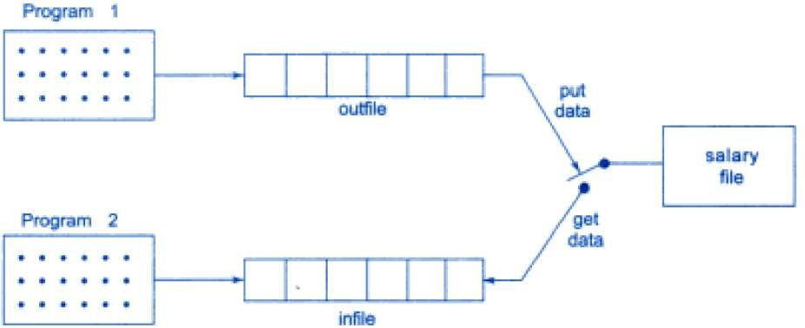
Two file stream working on one file
ofstream outfile (“ salary”); // create outfile and connects “salary” to it.
ifstream infile (“salary”); // create infile and connects “salary” to it.
These statements can be in same program or different program.
Connection with a file is closed automatically when stream object expires.
Or we can use outfile.close, infile.close () to disconnect outfile infile stream from “salary” file.

Slide 26
Opening a File
When a file is opened for writing only, a new file is created if there is no file of that name.
If a file with same name already exists, then its contents are deleted and the file is, presented as a clean file.
We shall discuss later how to open an existing file for updating it without losing its original contents.
Opening File using open()
The function open() can be used to open multiple files that use the same stream object.
For example, we may want to process a set of files sequentially. In such cases, we may create a single stream object and use it to open each file in turn.
Syntax:
stream object.open(“filename”);
.

Slide 27
Open and Close File Example:
A stream can be connected to only one file at a time. So before connecting it to another file we need to disconnect it from previous one.
#include <fstream>
#include <iostream>
using namespace std;
int main() {
ofstream outfile;
outfile.open("DATA1");
if (outfile.is_open()) {
outfile << "Hello, this is DATA1!\n";
outfile.close();
}
outfile.open("DATA2");
if (outfile.is_open()) {
outfile << "This is some content in DATA2.\n";
outfile.close();
}
cout << "Files written successfully!" << endl;
return 0;
}
.

Slide 28
Detecting end-of-file
Detection of the end-of-file condition is necessary for preventing any further attempt to read data from the file.
while (fin)
fin is the stream object which returns 0, if any error occurs in the file operation including end-of-file condition.
Or
if(fin.eof( ) != 0) {exit (1);}
eof() is the member function of ios class. It returns a non-zero value if the end-of-file(EOF) condition is encountered, and a zero(0) otherwise.
.

Slide 29
File opening modes
The general form of function open: (mode specify purpose for which file is open)
Stream-object.open(“filename”, mode);
Parameter | Meaning
ios:: app | Append to end-of-file
ios:: ate | Go to end-of-file on opening
ios:: binary | Binary file
ios:: in | Open file for reading only (default value for ifstream)
ios:: out | Open file for writing only (default value for ofstream)
ios:: trunc | Delete content of file if exists
ios:: nocreate | Open fails if the file does not exists
ios:: noreplace | Open fails if the file already exists
.

Slide 30
Mode of file opening
Opening a file in ios::out mode also opens it in the ios::trunk mode by default.
Both ios::app and ios::ate take us to the end of file when it is opened. The difference between the two parameters is that the ios::app allows us to add data to the end of file only, while ios::ate mode permits us to add data or to modify the existing data anywhere in the file. In both the cases, a file is created by the specified name, if it does not exist.
The parameter ios::app can be used only with files capable of output.
Creating a stream using ifstream implies input and creating a stream using ofstream implies output. So, in these case, it is not necessary to provide the mode parameters.
The fstream class does not provide a mode by default and therefore, we must provide the mode explicitly when using an object of fstream.
The mode can combine two or more parameters using the bitwise OR operator(symbol|).
Example:-
fstream file1,file2;
file1.open(“data1.txt”, ios::out|ios::in);
file2.open(“data2.txt”, ios::app|ios::nocreate);

Slide 31
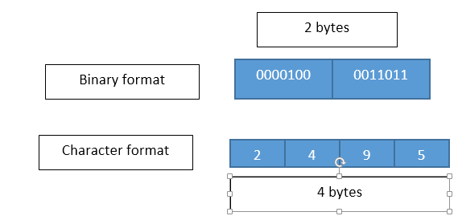
Binary Files
To read and write blocks of binary data: read( ) and write( ) function.
file . read ((char *)&V ,sizeof (V));
file . write ((char *)&V ,sizeof (V));
These function take two arguments. The first is the address of the variable V and the second is the length of that variable in bytes.
The address of variable must be cast to type char i.e. pointer to Character*(i.e. pointer to character type).

Slide 32
Example for read() and write() function:
Write a program that write and reads block of data to and from a file. #include<fstream> #include<iostream> #include<iomanip.h> using namespace std; const char* file_name = "Binary"; int main() { float height[4] = {100.123, 200.234, 300.345, 400.569}; float weights[4]; ofstream outfile (file_name); outfile.write((char *) & height, sizeof (height)); outfile.close(); | ifstream infile (file_name); if(infile.fail()) { cout<<"Input file does not exist. \n"; } infile.read((char *) & weights,sizeof (weight)); infile.close(); for(int i = 0; i < 4; i++) { cout<<setw(10); cout<<weights[i]; } }

Slide 33
Random File
Random Access Files allow direct access to specific locations within a file, rather than reading or writing data sequentially. This is particularly useful when dealing with large files, where accessing data directly is more efficient.
seekg(): moves get pointer (input) to a specified location
seekp() : moves put pointer (output) to a specified location
tellg() : gives the current position of the get pointer
tellp(): gives the current position of the put pointer
Ex: infile.seekg(10);
Moves the file pointer to the byte number 10. Remember, the bytes in a file are numbered beginning from zero. Therefore, the pointer will be pointing to the 11th byte in the file.

Slide 34
Random File
Example:
#include <iostream>
#include <fstream>
using namespace std;
int main() {
ifstream file("data.txt", ios::in); // Open "data.txt" in input mode
file.seekg(10, ios::beg); // Move the file pointer to the 10th byte from the beginning
char ch;
file.get(ch); // Read a single character from that position
cout << "Character at position 10: " << ch << endl;
file.close(); // Close the file
return 0;
}

Slide 35
Updating a File:Random Access
Updating is a routine task in the maintenance of any data file. The updating would include one or more of the following tasks:
Displaying the contents of a file.
Modifying an existing item.
Adding a new item.
Deleting an existing item.
These actions require the file pointers to move to a particular location that corresponds to the item/object under consideration.

Slide 36
File pointer operations used for random access
ofstreamfout;
fout. seekg(0, ios:: beg) -- go to start
fout. seekg(0, ios:: cur) -- stay at current position
fout. seekg(0, ios:: end) -- go to the end of file
fout. seekg(m, ios:: beg) -- move to m+1 byte in the file
fout. seekg(m, ios:: cur) -- go forward by m bytes from current position
fout. seekg(-m, ios:: cur) -- go backward by m bytes from the current position
fout. seekg(-m, ios:: end) -- go backward by m bytes from the end

Slide 37
Random Access Example
Search phone number on basis of name cout<<"Enter Name:"; cin>>name; file.seekg(0,ios::beg); found=0; while(file.read ((char *) &rec, sizeof (rec ))) { if(strcmp(name, rec.getname()) = = 0 ) found=1; rec.showdata(); } } file.clear(); if(found==0) cout<<"Record Not found n"; | Search name on basis of phone number cout<<"Enter Telephone Number"; cin>>telno; file.seekg(0,ios::beg); found=0; while(file.read ((char *) &rec, sizeof (rec ))) { if(strcmp(telno, rec.gettelno()) = = 0 ) found=1; rec.showdata(); } } file.clear(); if(found==0) cout<<"Record Not found n";

Slide 38
Update Telephone Number
cout<<"\n Enter Name : "; cin>>name; file.seekg (0,ios::beg); found=0 ; int cnt =0 ;//no. of objects has been read while(file.read ((char *) &rec, sizeof (rec ))) { cnt++; if(strcmp(nm,rec.getname ())==0) found=1; break; } } file.clear(); if(found==0) cout<<"n Record Not found n"; | else { int location = (cnt-1) * sizeof (rec); if(file.eof ()) file.clear(); cout<<"Enter New phone No :"; cin>>telno; file.seekp(location); rec.update(nm,telno); file.write((char *) &rec, sizeof (rec)); file.flush(); }

Slide 39


